Slide 1





Placementa.ai
Raghav Kapoor 219302268

Slide 2
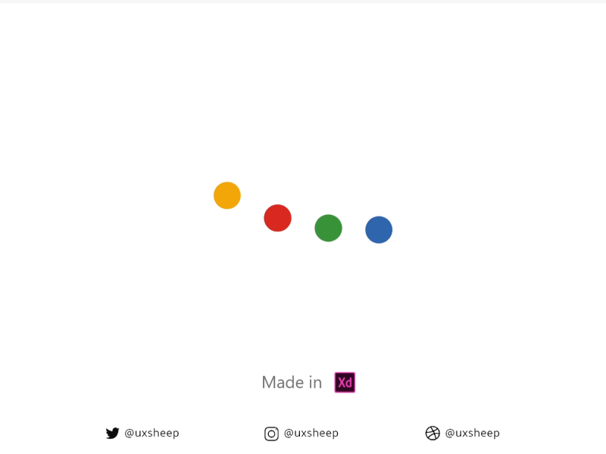






This what we all want to hear 🙉
These are Our Favourite Companies

Slide 3












STAGES OF STUDENT WHILE PREPARING FOR TECH JOB INTERVIEWS
Placementa.ai
A opportunity tracker + Resume ATS checker

Slide 4




Motivation
Simplifying Resume Creation:
Many individuals struggle with crafting an effective resume due to the lack of knowledge about the right format and structure.
Placementa.ai offers a solution by providing an ATS Resume Checker that evaluates resumes against job descriptions, helping users understand how to tailor their resumes for specific roles..
Accessibility and Convenience:
Continuous sign-ins and the need for specific software like Outlook can be deterrents for job seekers.
Placementa.ai eliminates these barriers by offering a web-based platform that is easily accessible to users, allowing them to engage with job opportunities and research postings effortlessly.
Expanding Opportunities:
By centralizing job openings and research opportunities on a single platform, Placementa.ai opens doors for students, faculty, and recruiters.
Users can explore a variety of opportunities within and outside the university, broadening their horizons and increasing their chances of finding the perfect match for their skills
Empowering Collaboration:
The social media aspect of Placementa.ai fosters collaboration and interaction among students, faculty, and recruiters.
It creates a supportive community where individuals can share insights, network, and support each other in their career and research endeavors, ultimately enhancing the overall job placement experience.

Slide 5
Introduction
Welcome to Placementa.ai, where innovation meets opportunity. In this presentation, we unveil a groundbreaking project aimed at transforming the job placement landscape for Manipal University Jaipur students and faculty. Through our AI-powered ATS Resume Checker and dedicated social media platform, we're redefining how job seekers connect with recruiters and explore career opportunities. Join us as we embark on a journey to streamline the job application process, foster collaboration, and empower individuals to achieve their career aspirations. Welcome to the future of job placement with Placementa.ai.
"Empowering careers, one connection at a time. Welcome to Placementa.ai"

Slide 6

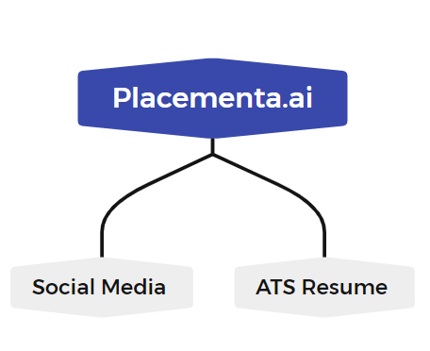
Objectives
To streamline the job application process for Manipal University Jaipur students and faculty by providing an AI-powered ATS Resume Checker that offers instant feedback on resume suitability, thereby reducing the time and effort required for job seekers to identify suitable opportunities.
To streamline the job application process for Manipal University Jaipur students and faculty by providing an AI-powered ATS Resume Checker that offers instant feedback on resume suitability, thereby reducing the time and effort required for job seekers to identify suitable opportunities.

Slide 7





TECH STACK
ATS Checker:
Python 3
PDF to Image Library
OS Library
Virtual Environment
Streamlit
Lang Chain Model: Google Gemini Pro + Hot Trending Prompt Engineering (with GenAI).
For Social Media
Design: Figma, Xmind, Whimsical
Backend: MySQL, Node.js, Express.js, Firebase (for authentication)
Frontend: React.js, Material-UI (MUI)
Tools
Technologies

Slide 8
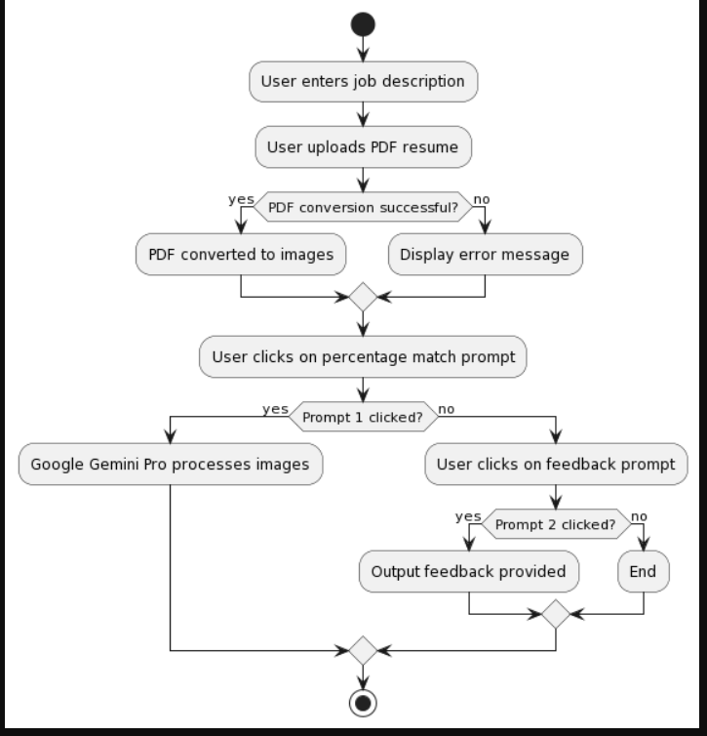
Activity Diagram ATS Checker

Slide 9
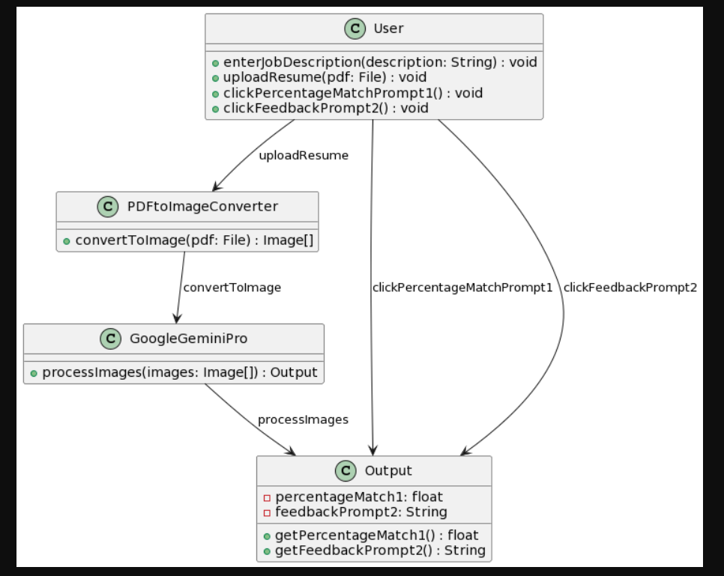
Class Diagram For ATS Cheker Functionality

Slide 10
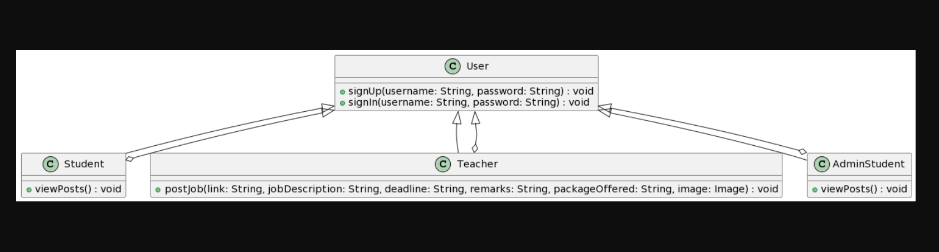
Class Diagram Social Media

Slide 11
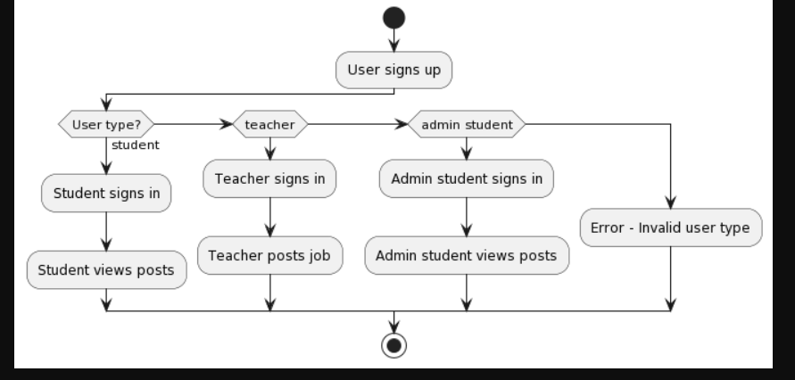
Activity Diagram Social Media

Slide 12
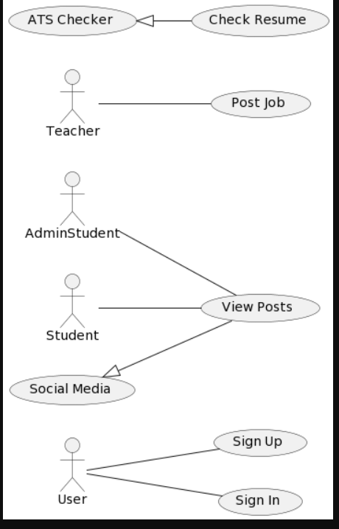
Use case Diagram

Slide 13
Functional Requirements
User Registration and Authentication:
Users should be able to register/sign up with the platform using their email address and create a password.
Upon successful registration, users should be able to sign in securely to access the platform's features.
ATS Resume Checker:
Users should be able to input job descriptions and upload their resumes for evaluation.
The ATS Resume Checker should analyze the resume and provide a percentage match indicating suitability for the job.
Users should receive instant feedback on their resume's compatibility with the job description.
Social Media Platform:
Students should be able to view job postings made by teachers and admin students.
Teachers should be able to post job openings, including job descriptions, application links, deadlines, and other relevant details.
Admin students should be able to view job postings and interact with them.
User Interaction:
Users should be able to interact with job postings by liking, commenting, and sharing them.
Teachers and admin students should be able to receive notifications for user interactions on their job postings.

Slide 14
Non-Functional Requirements
Performance:
The system should be responsive and provide quick feedback to users during resume checking and social media interactions.
The ATS Resume Checker should process resumes efficiently, even during peak usage times.
Security:
User data, including personal information and resumes, should be stored securely and protected against unauthorized access.
The platform should implement secure authentication mechanisms to prevent unauthorized access to user accounts.
Usability:
The user interface should be intuitive and easy to navigate for users of all technical skill levels.
Clear instructions and guidance should be provided throughout the platform to assist users in performing tasks effectively.
Scalability:
The system architecture should be designed to accommodate future growth and an increasing number of users.
The platform should be able to handle a large volume of job postings and resume evaluations as the user base expands.
Reliability:
The system should be available and accessible to users consistently, with minimal downtime for maintenance or updates.
Measures should be in place to ensure data integrity and prevent data loss in the event of system failures or disruptions.

Slide 15


Thank you

